Slide 1
STREAM CIPHERS
Notes:
Begrüßung
Thema zu Webtechnologien
Vor allem WebAssembly, Progressive Web Apps, Single Page Applications
Unscheinbar: LAMP is now MEAN
LAMP und MEAN: Akronyme für einen Stack an Webtechnologien (Stack == aufeinander bauende Softwarekomponente)
Ist LAMP noch Sinnvoll wenn es MEAN gibt? Vorteile von MEAN? Bzw. hat LAMP vlt Vorteile zu MEAN?
Deswegen Thema ausgewählt
Erste Frage: Was steckt hinter LAMP und MEAN

Slide 2
Security of stream ciphers based on LFSRs
Properties of LFSRs
Calculation of succeeding bits in advance to allow faster encryption calculate
Efficiently implemented in hardware with shift registers
Fast encryption of messages with unknown length like audio or video data
No error propagation if a bit is faulty
How secure are LFSRs?

Slide 3
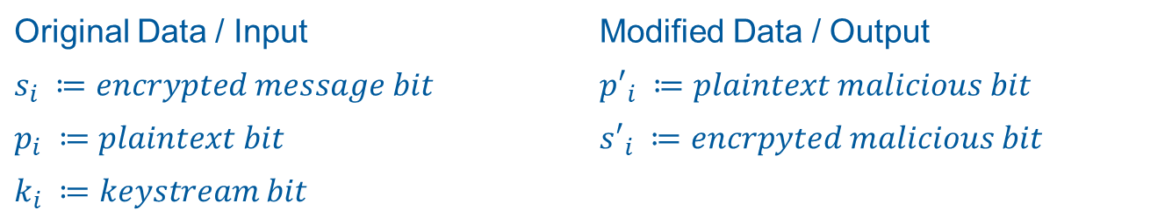

Security of stream ciphers based on LFSRs
Known-plaintext attack
Adversary knows parts of the plaintext and its location in the encrypted message
The original keystream can be calculated based on this information
Malicious data can be combined with the gained keystream to change final message
${(s}_{i}⊕p_{i})⊕{p^{′}}_{i}=\left((k_{i}⊕p_{i}\right)⊕p_{i})⊕{p^{′}}_{i}={(k}_{i}⊕0)⊕{p′}_{i}=k_{i}⊕{p′}_{i}=s_{i}′$
Original Data / Input | Modified Data / Output
$$s_{i} ≔encrypted message bit$$ | $${p′}_{i} ≔plaintext malicious bit$$
$$p_{i} ≔plaintext bit$$ | $${s′}_{i} ≔encrpyted malicious bit$$
$$k_{i} ≔keystream bit$$

Slide 4
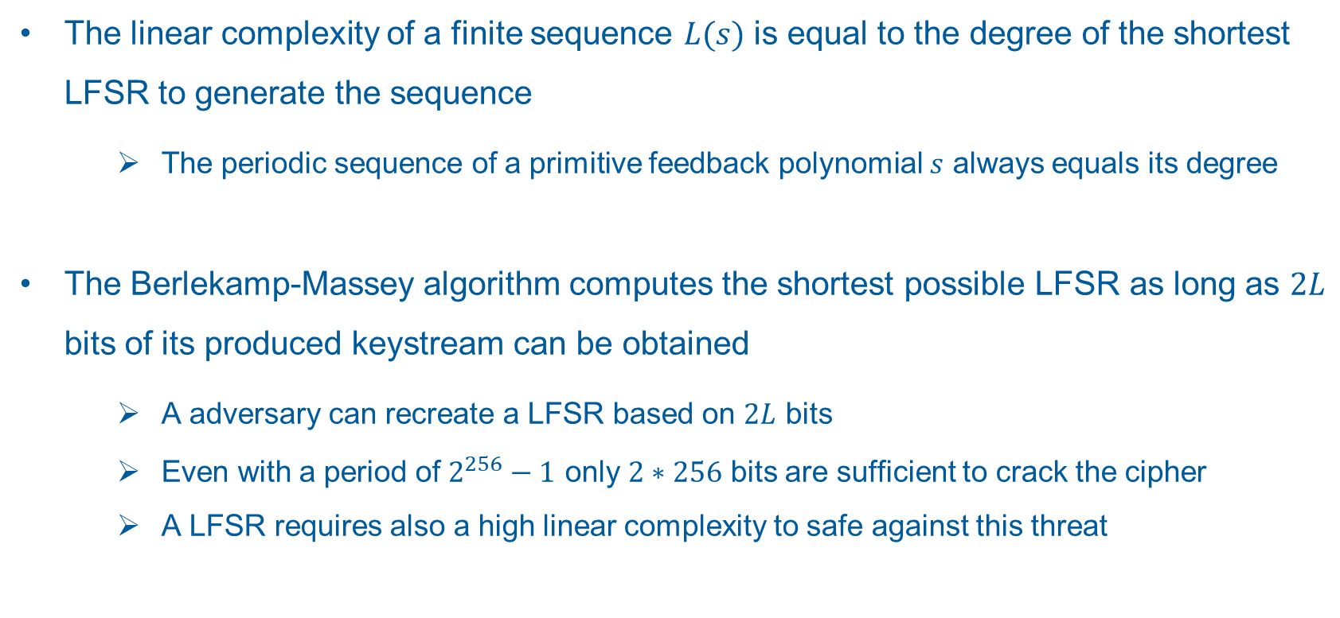
Security of stream ciphers based on LFSRs
Linear complexity and the Berlekamp-Massey algorithm
The linear complexity of a finite sequence $L(s)$ is equal to the degree of the shortest LFSR to generate the sequence
The periodic sequence of a primitive feedback polynomial $s$ always equals its degree
The Berlekamp-Massey algorithm computes the shortest possible LFSR as long as $2L$ bits of its produced keystream can be obtained
A adversary can recreate a LFSR based on $2L$ bits
Even with a period of $2^{256}−1$ only $2∗256$ bits are sufficient to crack the cipher
A LFSR requires also a high linear complexity to safe against this threat

Slide 5
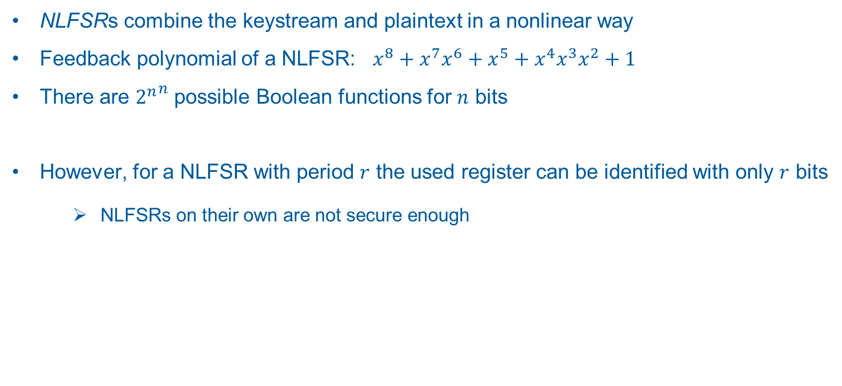
Increasing the cryptographic qualities of LFSRs
Nonlinear Feedback Shift Registers (NLFSR)
NLFSRs combine the keystream and plaintext in a nonlinear way
Feedback polynomial of a NLFSR: ${{{x^{8}+x}^{7}x}^{6}+x}^{5}+x^{4}x^{3}x^{2}+1$
There are ${2^{n}}^{n}$ possible Boolean functions for $n$ bits
However, for a NLFSR with period $r$ the used register can be identified with only $r$ bits
NLFSRs on their own are not secure enough

Slide 6
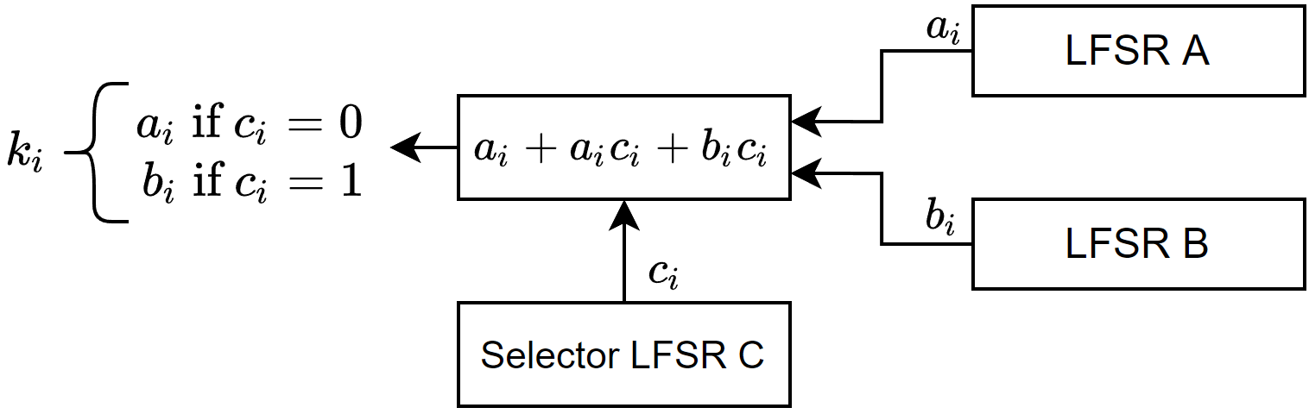
Increasing the cryptographic qualities of LFSRs
Combining Linear Feedback Shift Registers with an output generator
Chaining together multiple LFSRs with a nonlinear combination function
The Geffe Generator implements this principle:
Select output from one of two LFSRs based on the bit of another LFSR

Slide 7
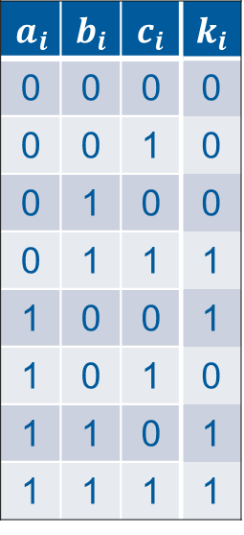
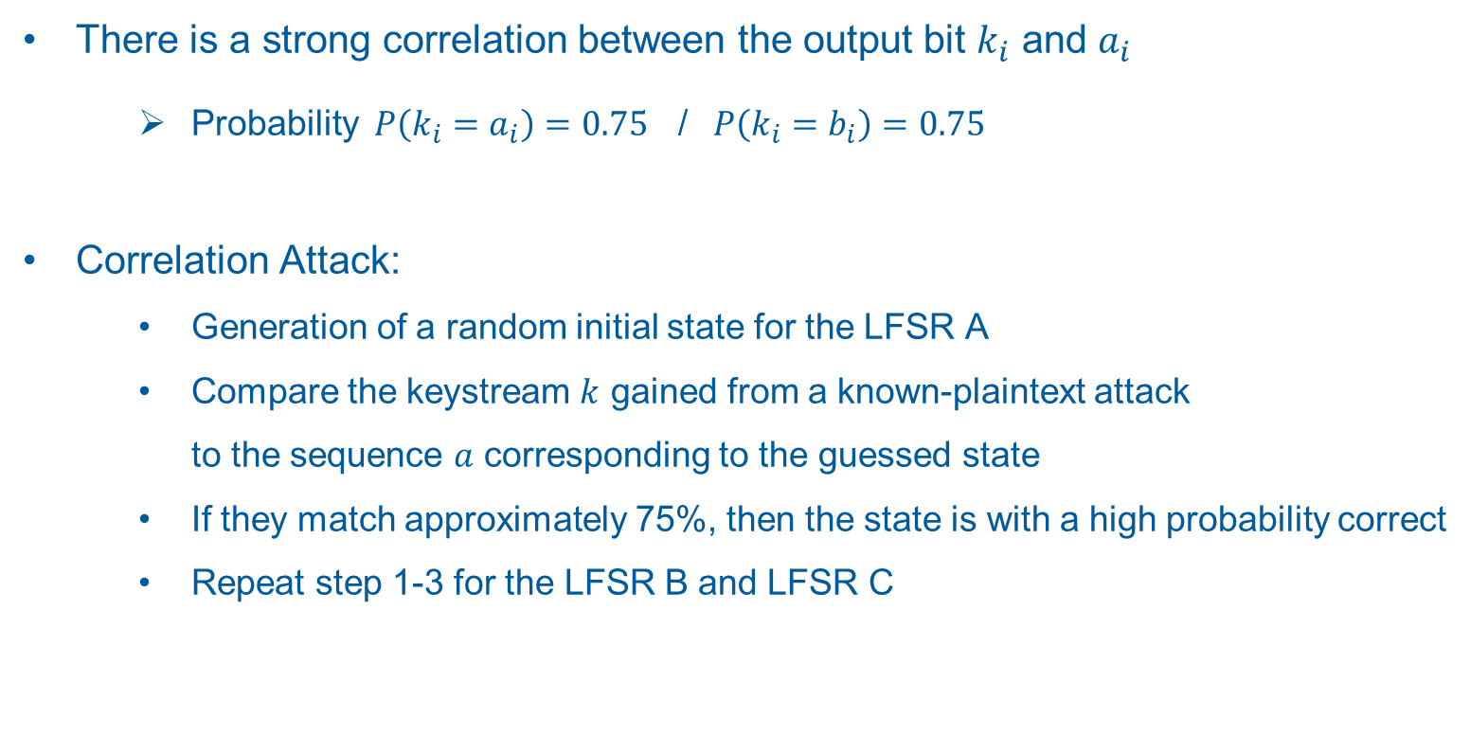
Increasing the cryptographic qualities of LFSRs
Correlation attack on the Geffe Generator
There is a strong correlation between the output bit $k_{i}$ and $a_{i}$
Probability $P\left(k_{i}=a_{i}\right)=0.75$ / $P\left(k_{i}=b_{i}\right)=0.75$
Correlation Attack:
Generation of a random initial state for the LFSR A
Compare the keystream $k$ gained from a known-plaintext attack to the sequence $a$ corresponding to the guessed state
If they match approximately 75%, then the state is with a high probability correct
Repeat step 1-3 for the LFSR B and LFSR C
$$a_{i}$$ | $$b_{i}$$ | $$c_{i}$$ | $$k_{i}$$
0 | 0 | 0 | 0
0 | 0 | 1 | 0
0 | 1 | 0 | 0
0 | 1 | 1 | 1
1 | 0 | 0 | 1
1 | 0 | 1 | 0
1 | 1 | 0 | 1
1 | 1 | 1 | 1

Slide 8
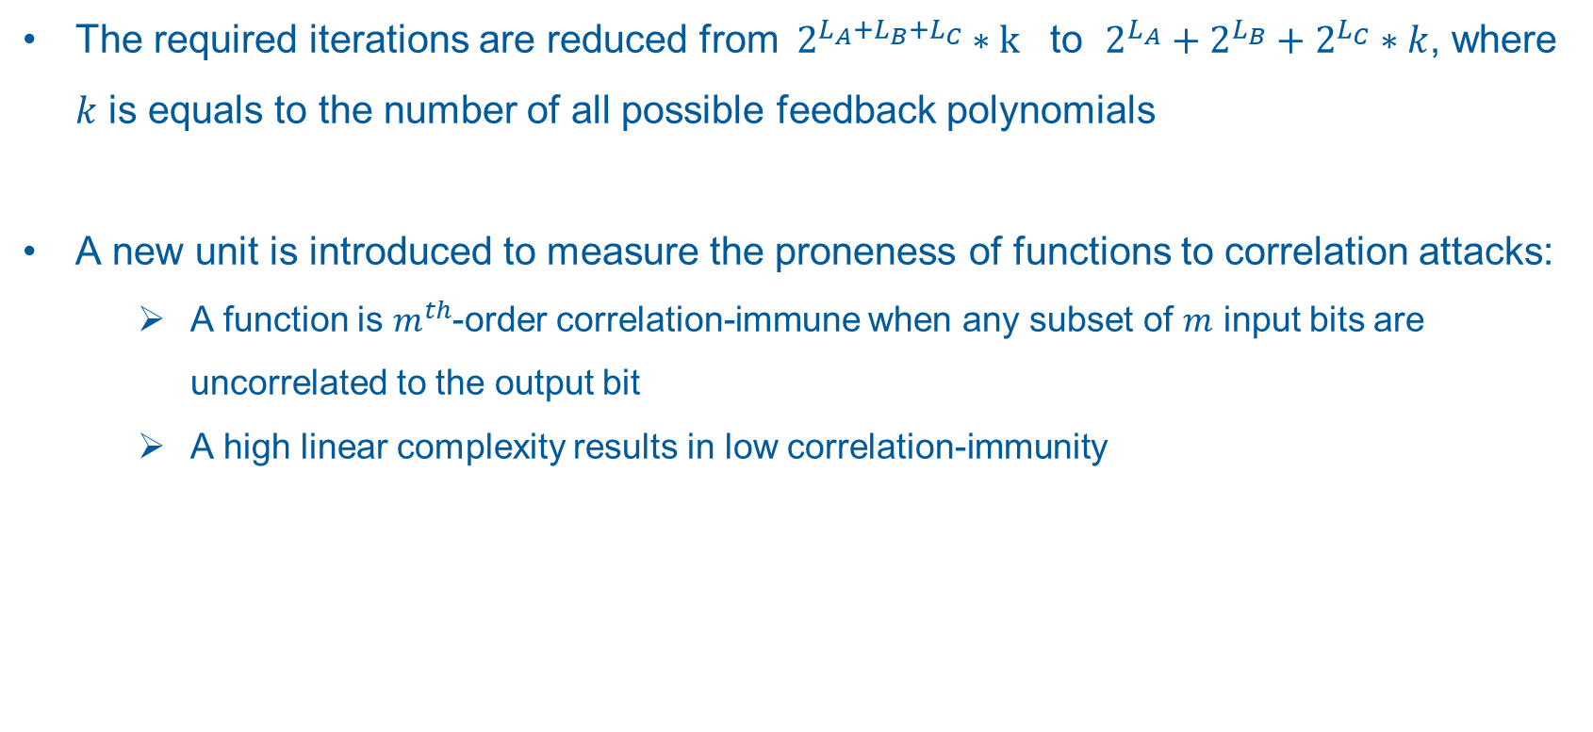
Increasing the cryptographic qualities of LFSRs
Correlation attack on the Geffe Generator
The required iterations are reduced from ${ 2}^{L_{A}+L_{B}+L_{C}} ∗\text{k}$ to $2^{L_{A}}+2^{L_{B}}+2^{L_{C}}∗k$, where $k$ is equals to the number of all possible feedback polynomials
A new unit is introduced to measure the proneness of functions to correlation attacks:
A function is $m^{th}$-order correlation-immune when any subset of $m$ input bits are uncorrelated to the output bit
A high linear complexity results in low correlation-immunity

Slide 9
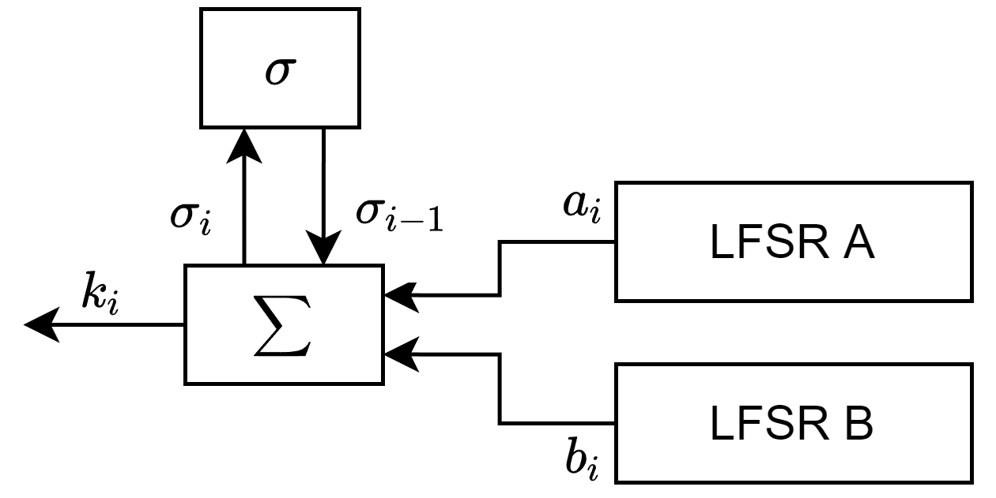
Increasing the cryptographic qualities of LFSRs
Extending nonlinear output generators with memory cells
To achieve maximum linear complexity and correlation-immunity simultaneously a memory component is added to the generators
The summation combiner uses integer addition with the memory acting as carry bit σ

